Slide 1




THE FUTURE
OF VEHICLES
INNOVATION, AUTOMATION & SUSTAINABILITY
Neelanga Sooriyaarachchi
28.05.2025

Slide 2

DRIVING INTO THE FUTURE
Rapid advancements in automotive technology.
Key trends shaping the future of vehicles.
Global focus on sustainability and smart mobility.

Slide 3


ELECTRIFICATION OF VEHICLES
RISE OF ELECTRIC VEHICLES (EVS)
Transition from internal combustion engines (ICE) to EVs
Environmental and economic benefits
Growth in EV adoption worldwide

Slide 4

AUTONOMOUS DRIVING
SELF-DRIVING TECHNOLOGY
Levels of vehicle autonomy (Level 0–5)
Companies leading autonomous tech (e.g. Tesla, Waymo)
Benefits: safety, efficiency, convenience

Slide 5

CONNECTED VEHICLES
THE INTERNET OF CARS
Vehicle-to-Everything (V2X) communication.
Real-time data sharing: traffic, weather, hazards.
Integration with smart cities and IoT.

Slide 6

SHARED MOBILITY
FROM OWNERSHIP TO ACCESS
Growth of ride-sharing and car-sharing platforms.
Reduction in vehicle ownership.
Cost-effective and eco-friendly transport solutions.

Slide 7

SUSTAINABLE MATERIALS
& DESIGN
GREEN MANUFACTURING
Use of recycled and renewable materials.
Lightweight, energy-efficient designs.
Circular economy in automotive production.

Slide 8

ALTERNATIVE FUELS
BEYOND ELECTRICITY
Hydrogen fuel cell vehicles (FCEVs).
Biofuels and synthetic fuels.
Comparing different zero-emission technologies.

Slide 9

SMART INFRASTRUCTURE
ROADS THAT THINK
Smart traffic lights and adaptive signals.
EV charging infrastructure.
Integration with 5G and AI for real-time traffic management.

Slide 10

CHALLENGES AND CONSIDERATIONS
WHAT STILL NEEDS WORK
Regulatory and ethical concerns (esp. autonomous driving).
Cybersecurity threats in connected cars.
Charging infrastructure and grid capacity.

Slide 11
VISION FOR 2035 AND BEYOND
WHAT WILL TOMORROW LOOK LIKE ?
Widespread EV and AV adoption.
Fully connected and intelligent mobility ecosystems.
Seamless integration with renewable energy.

Slide 12

THE FUTURE IS NOW
CONCLUSION
Vehicles are evolving rapidly.
Emphasis on clean, smart, and shared mobility.
A future defined by innovation and sustainability.

Slide 13


ADVANTAGES OF ELECTRIC VEHICLES

Slide 14
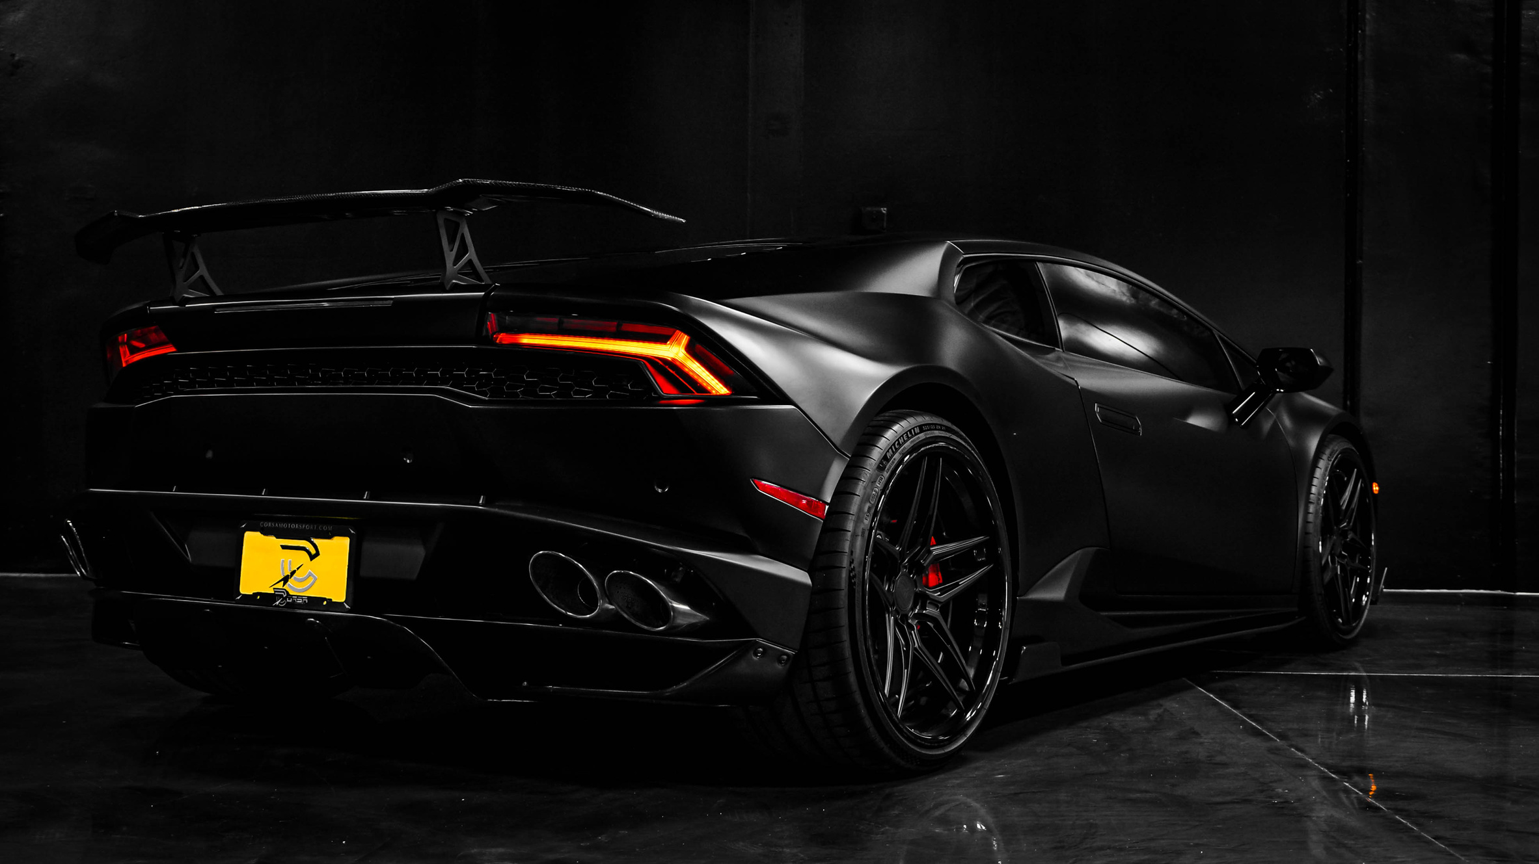
INTRODUCTION
WHY ELECTRIC VEHICLES MATTER
Rising environmental concerns
Shift toward sustainable transportation
Growing EV market globally

Slide 15
ENVIRONMENTAL BENEFITS
CLEANER ENVIRONMENT
Zero tailpipe emissions
Reduced air pollutants (NOx, SOx, CO₂)
Decreased noise pollution

Slide 16
ECONOMIC ADVANTAGES
COST SAVINGS
Lower fuel costs (electricity vs gasoline)
Fewer moving parts = reduced maintenance
Incentives and tax credits in many regions

Slide 17
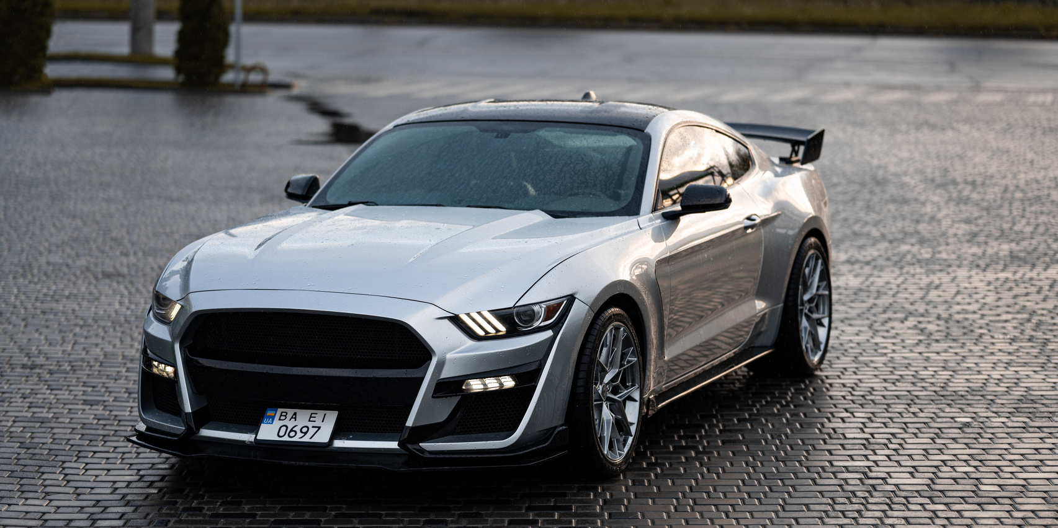
PERFORMANCE BENEFITS
ENHANCED DRIVING EXPERIENCE
Instant torque and smooth acceleration
Lower center of gravity = better handling
Quiet and comfortable ride

Slide 18
ENERGY EFFICIENCY
BETTER ENERGY UTILIZATION
EVs convert over 77% of electrical energy to power at the wheels
Conventional gasoline vehicles only convert about 12%–30%

Slide 19
TECHNOLOGICAL ADVANCEMENTS
INNOVATION & SMART FEATURES
Regenerative braking
Smart connectivity & over-the-air updates
Autonomy-ready platforms

Slide 20
INFRASTRUCTURE & GROWING SUPPORT
EXPANDING ECOSYSTEM
Rapid growth of charging stations
Government support and green policies
Investments by major automakers

Slide 21
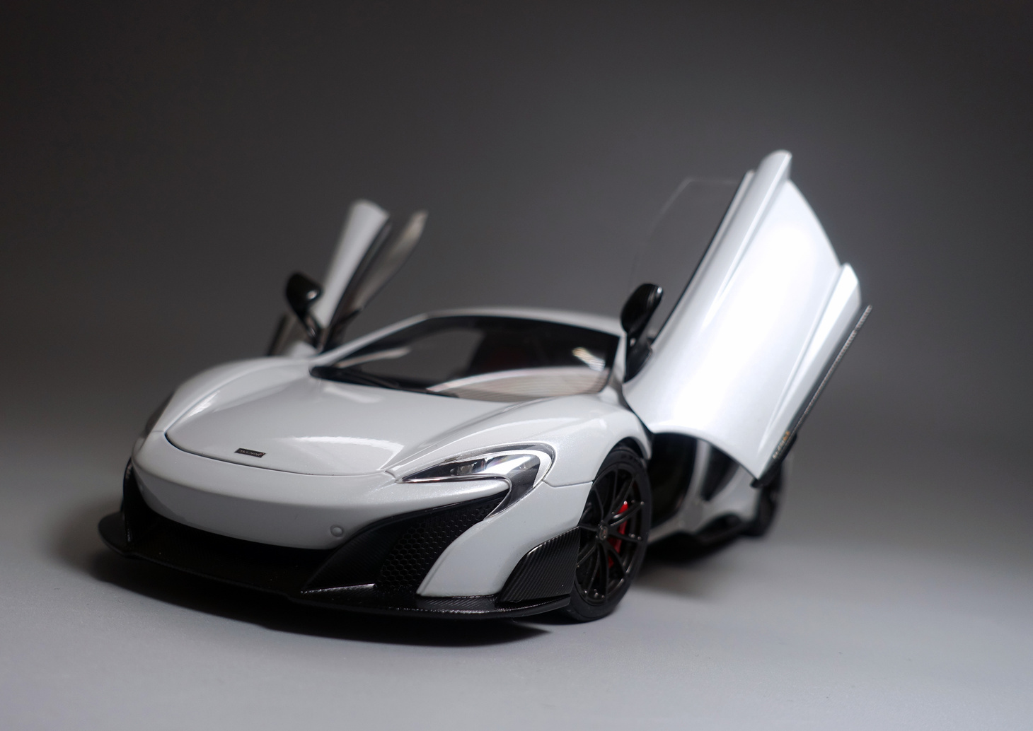
CHALLENGES BEING OVERCOME
OVERCOMING LIMITATIONS
Improved battery technology = longer ranges
Faster charging options
Drop in EV prices over time

Slide 22

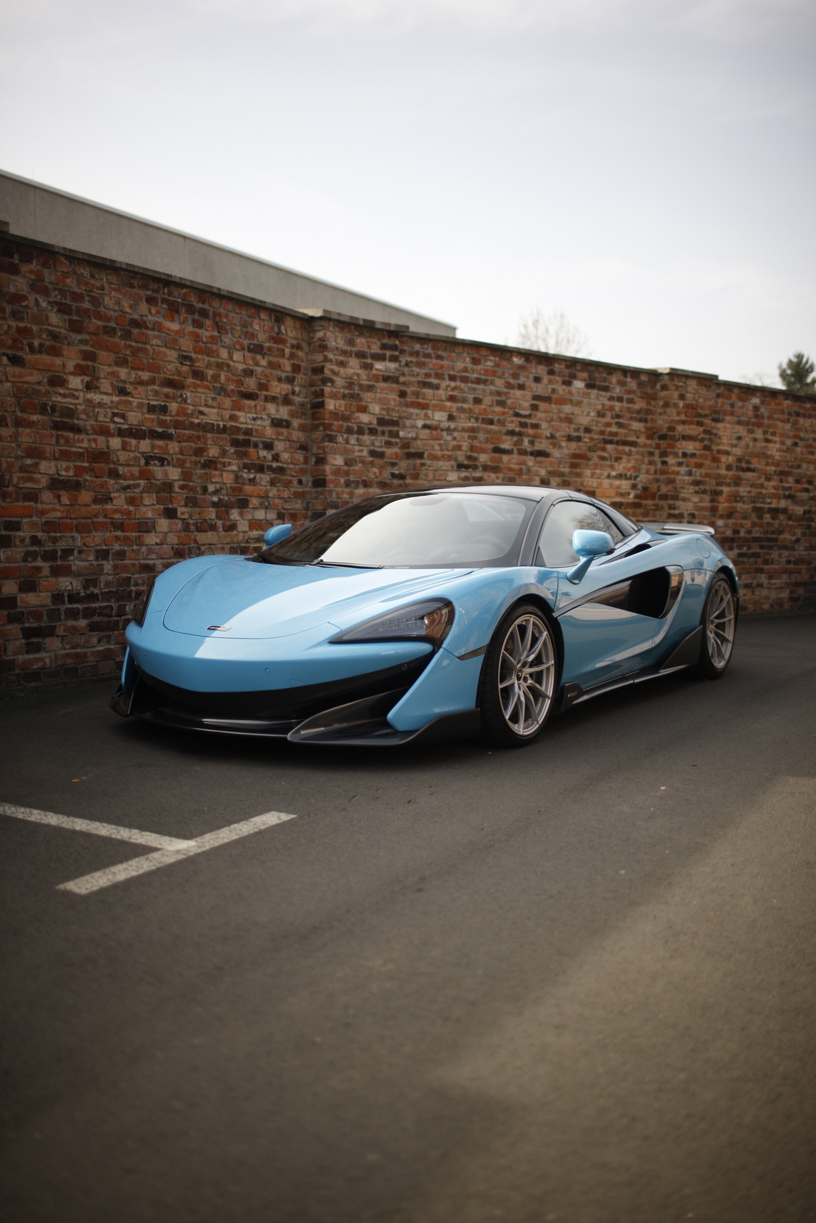
FUTURE OUTLOOK
A SUSTAINABLE TOMORROW
Projection: Majority of new cars will be electric by 2035
Global effort toward net-zero emissions
Integration with renewable energy sources

Slide 23

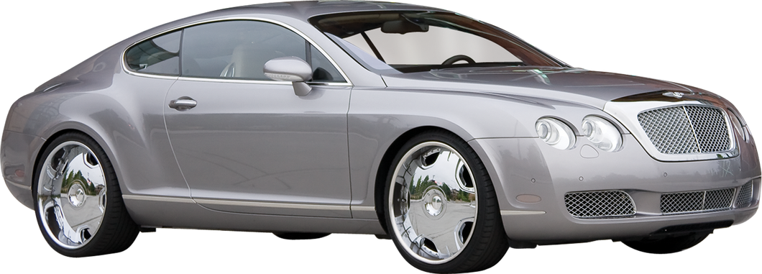
CONCLUSION
THE ROAD AHEAD IS ELECTRIC
EVs are environmentally, economically, and technologically superior
Growing global momentum
Now is the time to go electric!

